Slide 1
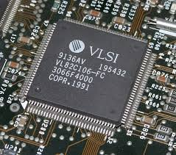
VLSI DESIGN FLOW
By : MD SHAKIL ANSARI

Slide 2
CONTENTS
Introduction
Evolution of VLSI Technology
VLSI Design Flow
System Specification
Architecture
Functional Design
Logic Design
Circuit Diagram
Physical Design
Fabrication
Packaging & Testing

Slide 3
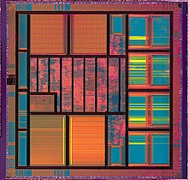
INTRODUCTION
Very large-scale integration (VLSI) is the process of creating an integrated circuit (IC) by combining millions of MOS transistors onto a single chip .
An electronic circuit might consist of a CPU, ROM, RAM and other glue logic. VLSI lets IC designers add all of these into one chip.
A VLSI IC die

Slide 4
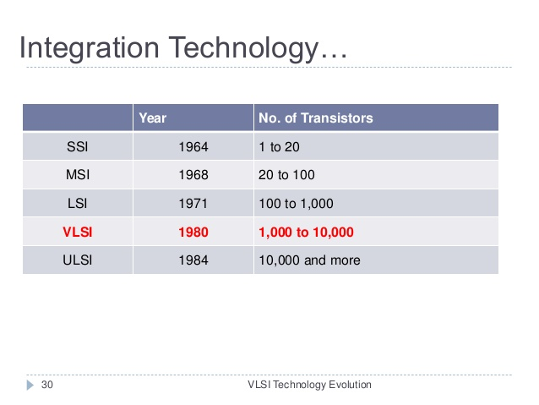
Evolution of VLSI Technology
The designing evolution of digital IC is based on the idea of fabricating more number of transistors in a small single piece of semiconductor wafer.

Slide 5
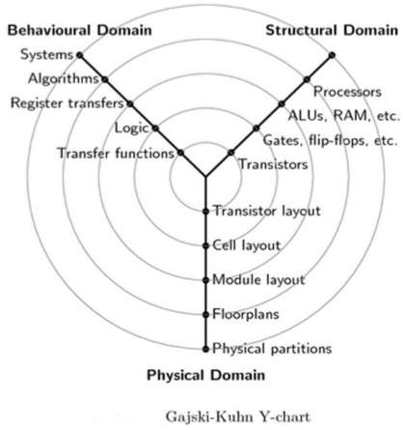
VLSI Design Flow
The VLSI design can be clearly explained with the help of Y-chart shown below.
It divides the entire process into into 3 domain – structural, behaviour and physical .

Slide 6
VLSI Design Flow
The design flow starts from
The algorithm is decided .
Then architecture is choosen .
Then mapped onto chip surface i.e , floorplanning .
Then define the finite state machines .
Then implement the finite state machine with functional modules
then placing the modules onto the chip surface .
then implementing modules with leaf cells (i.e., logic gates)then cell placement and routing
then transistor level implementation of leaf cells
then mask generation

Slide 7
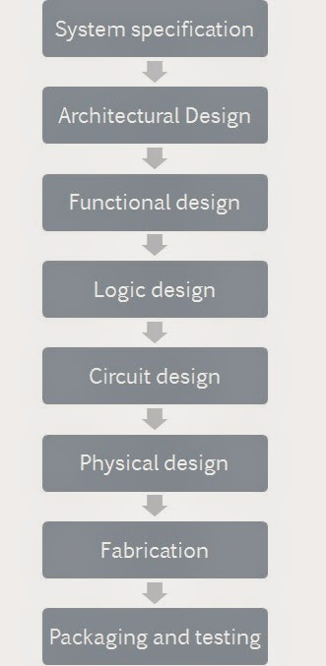
VLSI Design Flow Contd…
Now each stage of design is considered in a separate heading
System Specification : performance ,functionality and physical dimension of the chip is taken into consideration
Architectural Design : Decision like
RISC/CISC, number of ALUs ,pipeline
Structure are taken under this step
Functional Design : Here the main
Functional unit of the system is
Identified

Slide 8
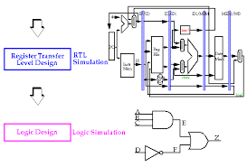
VLSI Design Flow Contd…
Logic Design : The control flow, register allocation etc are being considered
Circuit Design : Here the Boolean representation are converted into circuit representation
Physical Design : In this step the
circuit representation is
Converted into geometrical
representation.

Slide 9
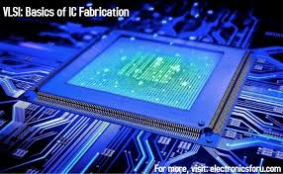
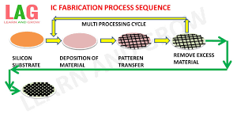
VLSI Design Flow Contd…
Fabrication : After layout and verification , the design is ready for fabrication
Packing & Testing : Finally , the wafer is fabricated and and diced into individual chips in a fabrication facility . Each chip is then packaged and tested to ensure to meet all design specification

Slide 10


